Slide 1

JS Core 2
Week 2
Created: 2020-05-25, Last Edited: 2020-05-29 | Authors: Abdoulrazack, Alin, Mozart | Reviewers: Jane. Zoli, Chris

Slide 2
JS in the Browser
DOM

Slide 3
By the end of this lesson you should be able to:
1- Define what the DOM is and what it does
2- Use query selectors to retrieve elements from the DOM
3- Use event listeners to respond to events that happen on the DOM
4- Create DOM elements using JavaScript and add them to the DOM
5- Manipulate DOM elements using JavaScript to change their properties

Slide 4
Lesson Content
DOM
Access DOM elements
Attach events to DOM elements
Create DOM elements
Manipulate DOM element

Slide 5
1-Definition DOM
Document Object Model
A standard object model
Programming Interface
It is formed when a web page is loaded..

Slide 6
1- Usage of DOM
DOM defines
The HTML elements as objects.
The properties of all HTML elements.
Methods to access all HTML elements.
Event for all HTML elements.
Javascript gets Power but how ?

Slide 7
1- DOM and Javascript
With the help of DOM Javascript can:
Create a dynamic website.
Change all the HTML elements in the page
Modify all the HTML attributes in the page
Change all the CSS styles in the page
Delete existing HTML elements and attributes
Add new HTML elements and attributes
React to all existing HTML events in the page
Create new HTML events in the page

Slide 8

1- Representation of DOM tree Object

Slide 9
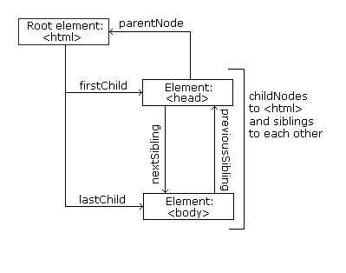
1- Node relationship
<html> is the root node
<html> has no parents
<html> is the parent of <head> and <body>
<head> is the first child of <html>
<body> is the last child of <html>

Slide 10
Demo

Slide 11
Access DOM elements

Slide 12
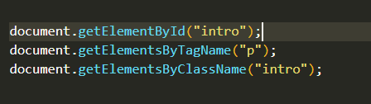

2- Access DOM elements

Slide 13
2- Navigate between Nodes
.parentNode gets you the parent element of a child.
.childNodes[nodenumber] gets the specified child of a parent element.
.firstElementChild gets first element child of a parent element.
.lastElementChild gets last element child of a parent element.
.nextElementSibling gets next sibling element of an element child.
.previousSibling gets before sibling element of an element child.
.innerHTML gets the content of the element.

Slide 14
Demo

Slide 15
exercise

Slide 16
Events and Handlers

Slide 17
Event
Handler
Something has happened
Do some thing about it
Notes:
Events are actions or occurrences that happen in the system you are programming. The system fires off a signal of some kind when an event occurs, and also provides a mechanism by which some kind of action can be automatically taken (that is, some code running) when the event occurs. For example in an airport when the runway is clear for a plane to take off, a signal is communicated to the pilot, and as a result, they commence piloting the plane.

Slide 18
Event
Handler
It starts to rain
Get out umbrella
I get robbed
Call the police
Boyfriend calls
Block number
Notes:
Events are actions or occurrences that happen in the system you are programming. The system fires off a signal of some kind when an event occurs, and also provides a mechanism by which some kind of action can be automatically taken (that is, some code running) when the event occurs. For example in an airport when the runway is clear for a plane to take off, a signal is communicated to the pilot, and as a result, they commence piloting the plane.

Slide 19
Examples of Web browser events
click
keypress
drag
message
mouseover
scroll
https://developer.mozilla.org/en-US/docs/Web/Events
Notes:
2. tend to be attached to a specific item that resides in it — this might be a single element, set of elements, the HTML document loaded in the current tab, or the entire browser window. 3. There are a lot of different types of events that can occur, for example:
The user clicking the mouse over a certain element or hovering the cursor over a certain element.
The user pressing a key on the keyboard.
The user resizing or closing the browser window.
A web page finishing loading.
A form being submitted.
A video being played, or paused, or finishing play.
An error occurring.
You can gather from this (and from glancing at the MDN Event reference) that there are a lot of events that can be responded to.

Slide 20
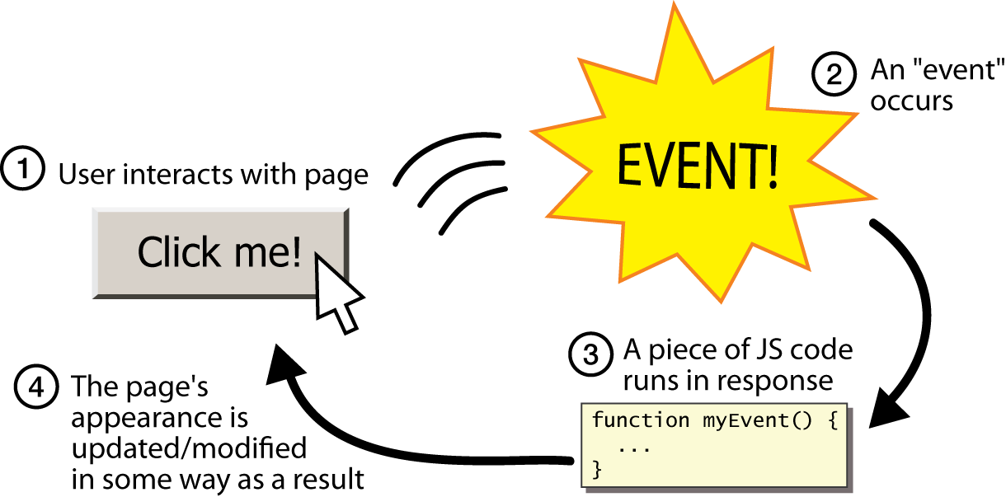
Interacting with DOM elements
Photo src: https://www.webstepbook.com/supplements/slides/ch07-javascript.shtml

Slide 21

Interacting with DOM elements - the code
Get the element
const myElement = document.querySelector(‘button’);
Listen for an event
myElement.addEventListener(‘click’, ...)
Do something
myElement.addEventListener(‘click’, function () { // add code })
Function that handles the event
Notes:
Our addEventListener() method takes 2 arguments (usually). First: what is the TYPE of events that you want to listen to.
The second argument is what’s called an anonymous CALLBACK FUNCTION! Whoop, whoop! Buzzword! Buzzword alert!
A callback function is just a regular function, not a special type of function
A callback is just a word we use to describe a function that pass to a method that will be then called a later point in time
Instead of us calling the function, we provide the name or a reference to a function, to addEventListener() and then the browser will take care of calling or running that function for us when it needs to
It’s similar to saying: “Hey browser, I made this function. When someone clicks my button, could you be a darling and run it for me? Thanks a lot”
It’s an anonymous function because there’s no name to this function, there’s no way for us to reference this function outside of here

Slide 22
DEMO (click event)

Slide 23
Task 2 10 min

Slide 24
Event Arguments

Slide 25
Web browsers give our event handlers information to help us do things
let updateBtn = document.getElementById('updateButton');
updateBtn.addEventListener('click', onUpdateButtonClicked);
function onUpdateButtonClicked(eventArg) {
// Do something!
}
Information about the event

Slide 26
DEMO
Event Arguements
Change style

Slide 27
Task 3 10 min

Slide 28
Create DOM Elements - Live Walkthrough
1. Create an new element
2. Select where you want it to go
3. Add the element

Slide 29
Task 4 25 min

Slide 30
Task 5 15 min

